Slide 1
Introduction
Name – Pushpraj Singh
Roll no. – 2204030102418
Model – M1A4
Website name – Sneaker_Store
Website type – e-Commerce

Slide 2
Explanation
Here, user can buy sneakers.
Firstly user have to login into our website.
After this user visit our website and choose sneakers .
Here user can see the price and rating of the products.
They can give ratings to the products.
User also raise a request for contact.
We create custom products for users.

Slide 3
Features
Responsive
Here we can login using id and pass ( id- abcd, pass- 1234).
Simple and easy to use.

Slide 4
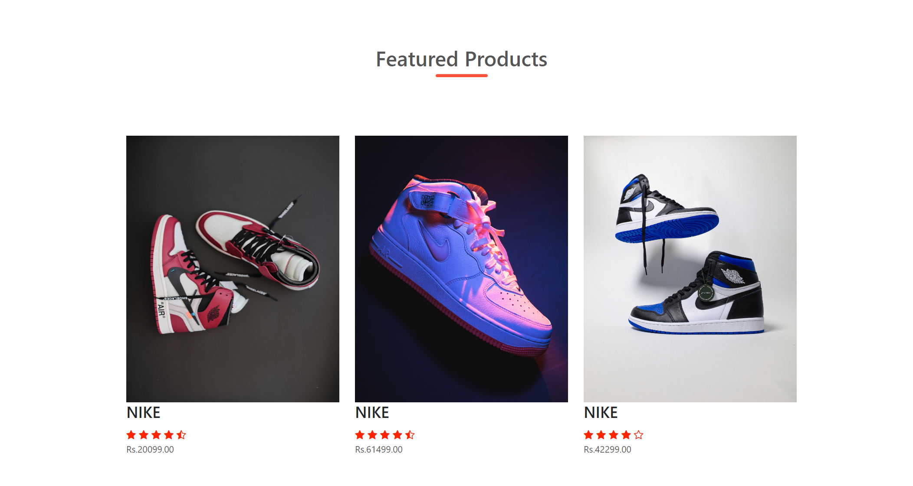
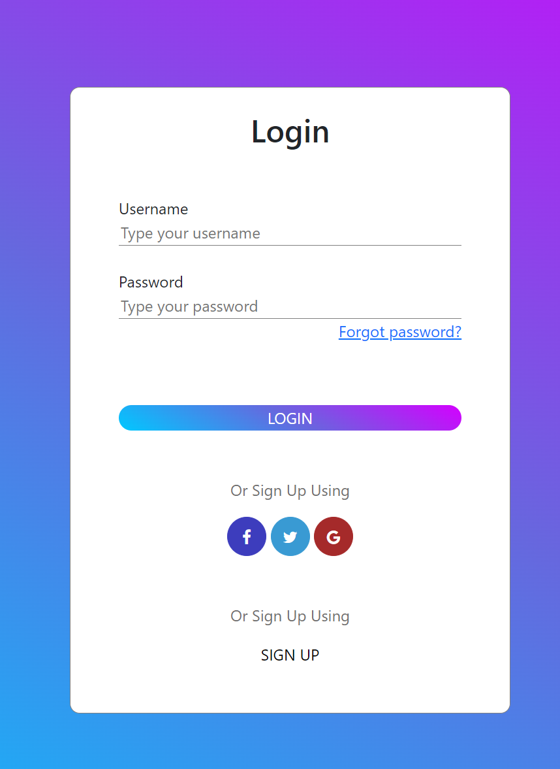
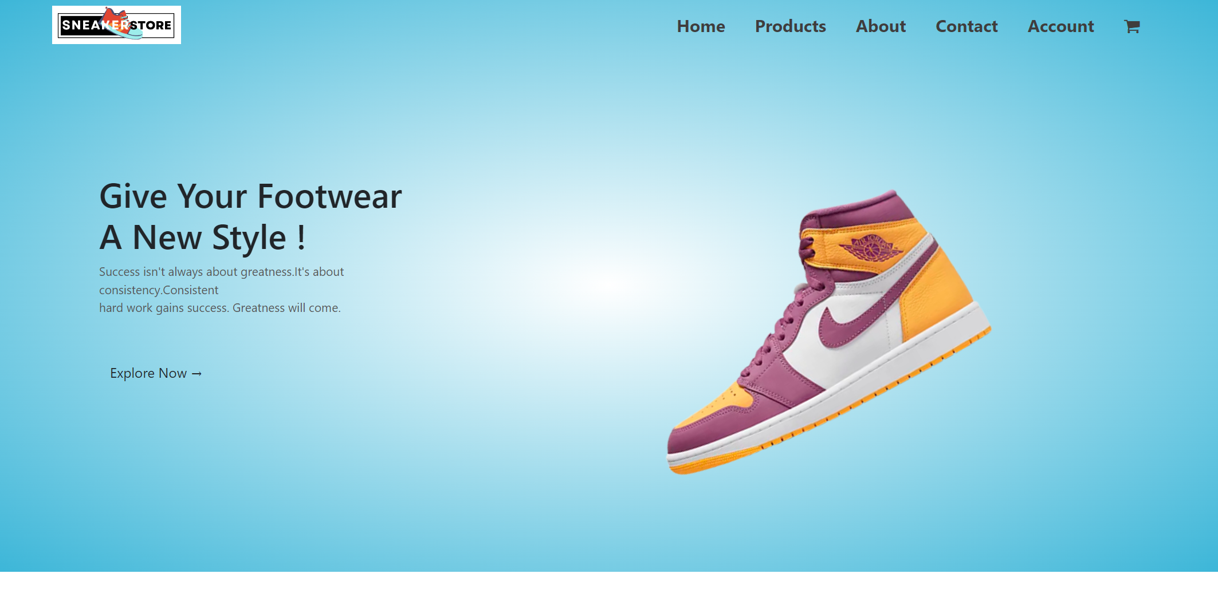
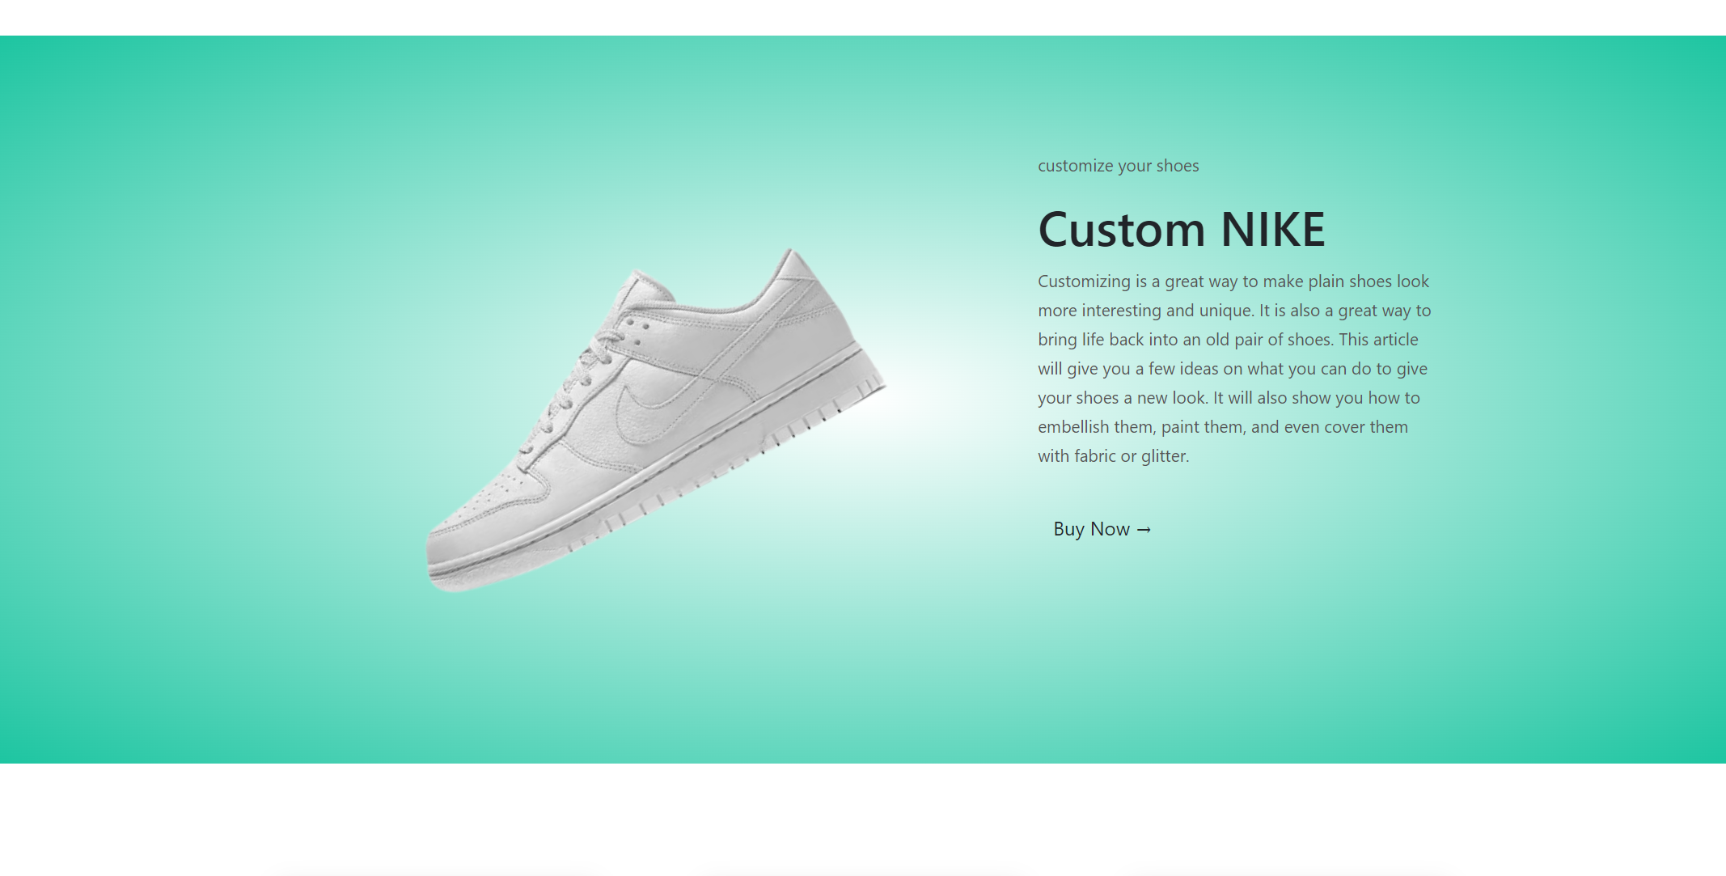
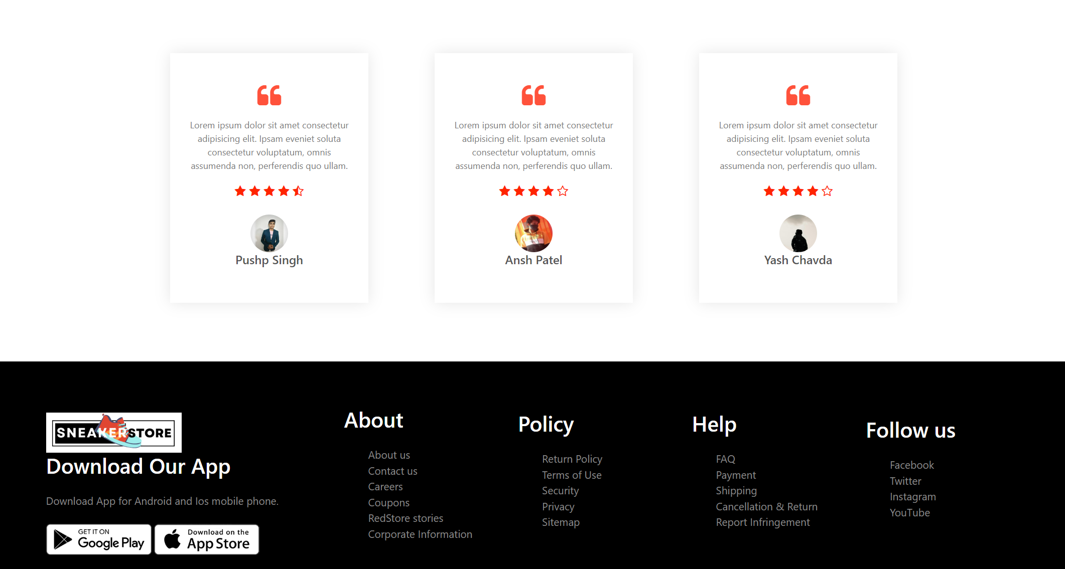
Here are some screenshots of website

Slide 5
Thank you…..

